Slide 1
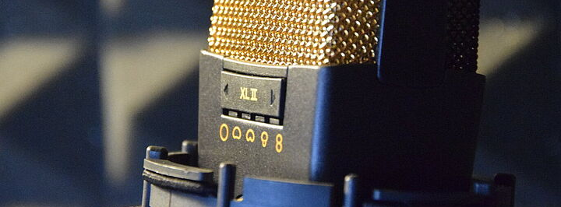
Room Reverberation Effectively Masks Deepfake Traces
Sophie Hoppe, Anabell Hacker, Markus Brückl | TUB - Chair of Speech Communication | ITG Conference on Speech Communication | 25.09.2025
Notes:
Good afternoon. I hope I still have your attention for the last talk of today. My name is Sophie Hoppe, and I am here together with my colleagues Annabell Hacker and Markus Brückl from the Chair of Speech Communication at the Technische Universität Berlin.
We would like to share with you one of our recent studies, which addresses the challenges of detecting audio deepfakes under realistic room reverberation conditions.

Slide 2
Structure of the Presentation
Motivation
Approach
Experimental Setup
Original Audio Files
Generation of Audio Deepfakes
Re-recordings
Detection and Scoring
Statistical Methods
Results
Key Findings
Discussion
Notes:
First, I will talk about our motivation and then explain the approach of our study and then outline of the experimental setup.
Afterwards, Markus will present the key results of our study and lead us into the final discussion.

Slide 3
Motivation
Rapid advances in AI speech synthesis → highly realistic audio deepfakes
Threats: trust in media, information security, communication integrity
Need: practical evaluation of detection tools under realistic acoustic conditions
Notes:
In recent years, AI speech synthesis has advanced rapidly.
Today, highly realistic audio deepfakes can be created that are hardly distinguishable from genuine speech.
This poses serious risks not only to communication and information security, but also to public trust in media.
The consequence of this is that research into detection systems for such deepfakes has also increased significantly in recent years.
Our study aims to explore weaknesses of current detection systems, especially when recordings are altered by room reverberation, which represents a realistic attack scenario on those detection systems.

Slide 4
Approach
Combine:
BrandDB corpus (actor portrayals of brand personalities)
ElevenLabs AI voice synthesis (cloning of voice and speaking style)
DeepFake Total detection tool (web interface)
Test robustness of detection under realistic room reverberation conditions
Notes:
Our research relies on three openly accessible components:
BrandDB corpus (developed at TU Berlin) – which we used for the original speech material.
ElevenLabs (a well-known AI Voice Cloning system) – which we used to generate the synthetic voices and utterances.
Deepfake Total (developed by the Cognitive Security Technologies department of the Fraunhofer Institute for Applied and Integrated Security) – which is a detection system explicitly created to detect AI-generated speech.
Together, these provide a framework that is both scientifically grounded and practically relevant.

Slide 5
Original Audio Files
BrandDB corpus: 7 speakers (3 female, 3 male, 1 non-binary)
5 brand personality dimensions (Aaker, 1997):
Sincerity, Excitement, Competence, Sophistication, Ruggedness
Slogans (German, neutral marketing-like tone)
‘You are our customer, we are your brand’
Validation: 79 listeners confirmed brand personality perception
‘Best case‘ exemplars
→ Output: 35 dimension-specific original utterances (5 dimensions * 7 Speaker)
‘Du bist unser Kunde, wir sind deine Marke’ (informal)
‘Sie sind unser Kunde, wir sind Ihre Marke’ (formal)
Notes:
The BrandDB corpus contains audios of seven actors (3 female, 3 male, 1 non-binary), who vocally portrayed the five brand personalities established by Aaker in 1997.
The seven speakers recorded two German marketing-like slogans, in one formal and one informal version.
The Slogans can be translated to English as: “You are our customer, we are your brand.”
Each actor produced 36 utterances in total – three repetitions for each dimension and address form, plus six utterances in their neutral speaking voice.
The recordings were made in a soundproof booth, at a 48 kHz frequency and a 16-bit resolution.
A perception study with 79 listeners confirmed that the intended personalities were reliably recognized.
From this, the 35 best-case samples – which represented the most effective realisation of the intended brand personality dimension – were selected as the basis for our analysis and our original audio samples.

Slide 6
Generation of Audio Deepfakes
Tool: ElevenLabs Instant Voice Cloning
Training: 36 utterances per speaker → concatenated input
Parameters and settings → Preserved breathing, micro-pauses, neutral artifacts
→ Output: 7 individual Voice Clones
Style and Prosody Transfer
Model: Eleven Multilingual v2 (STS)
Replicated not only voice timbre but also speaking style
→ Output: 35 dimension-specific synthetic utterances (5 dimensions * 7 Speakers)
Notes:
For each speaker, we concatenated their full set of 36 utterances from de BrandDB corpus into one FLAC file to train a voice clone with ElevenLabs.
The default settings were used, except that “Remove Background noise from audio recording” was disabled, in order to preserve the natural vocal characteristics of the voices like breathing noises, micro-pauses and other fine-grained artifacts.
We then used the “Voice Changer” tool with the Eleven Multilingual v2 model to reproduce not only the voices but also the speaking styles of the best-case samples.
This resulted in 35 dimension-specific deepfake audios.

Slide 7
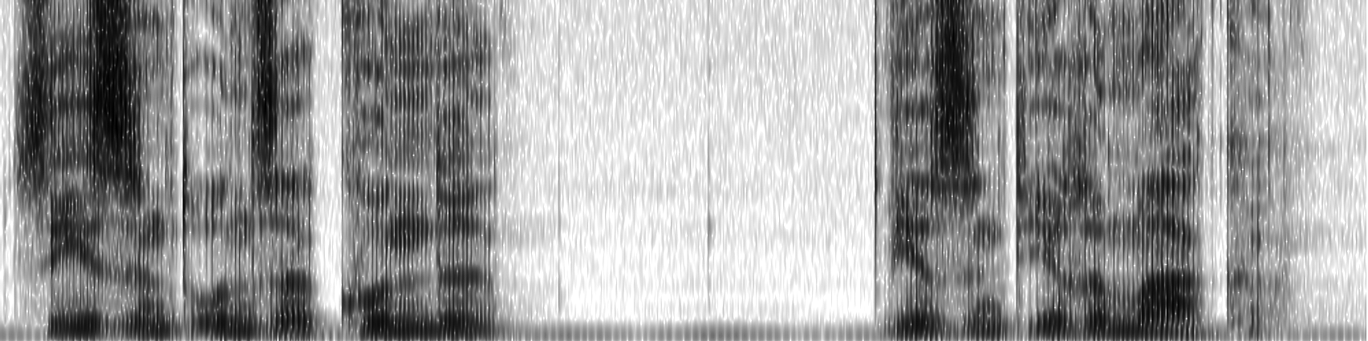

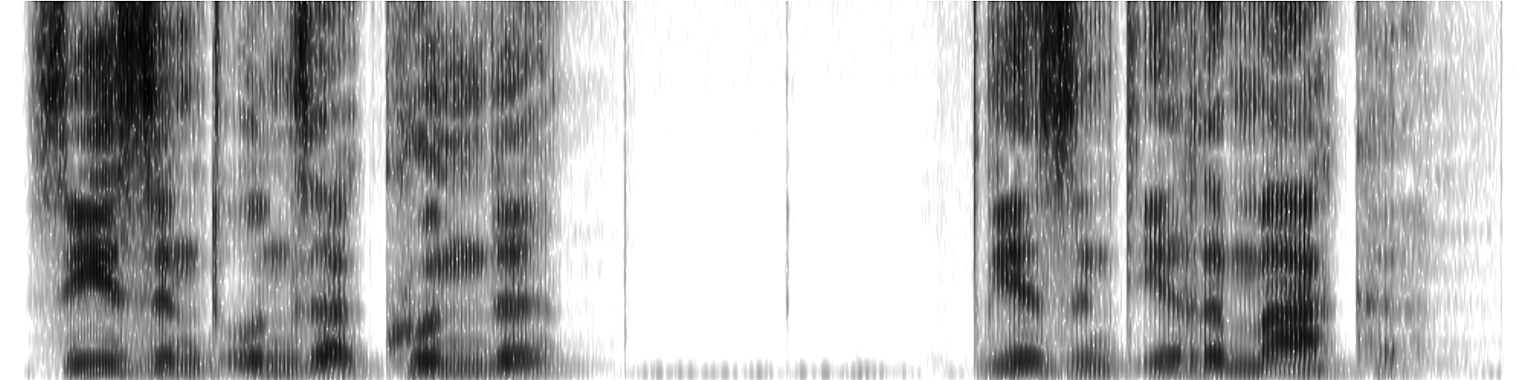

Audio Examples: Original vs. Fake
Figure 1: Spectrogram of Audio file m1_co_sie_3_o.wav (Praat)
Figure 2: Spectrogram of Audio file m1_co_sie_3_f.wav (Praat)
Notes:
To illustrate this more clearly, I have brought two short audio examples.
The first is an original recording from the BrandDB corpus, and the second is a deepfake version of the same recording, generated with ElevenLabs.
By the way, if you want to have a further look into the audio files, you can find them on our website. The link is in our paper.

Slide 8
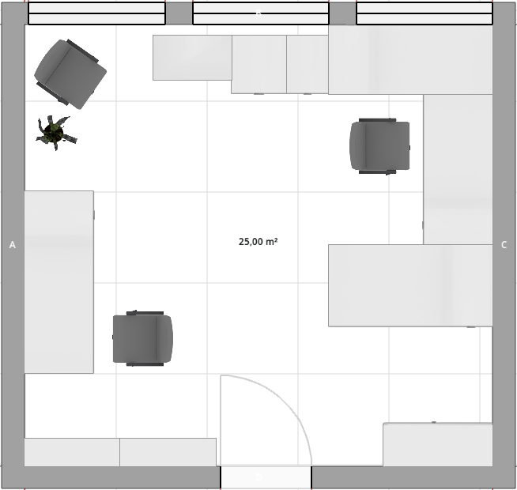
Re-recordings
Office room: 25m², 3m ceiling hight, furnished → natural reverberation and absorption
Playback: Studio monitor (Tannoy Reveal Active)
Recording: Microphone (AKG C414 XLII), listener-like position ~ 2m
Conditions:
Room Reverberation (rr): cleanly cut recordings
Room Reverberation with Pause (rrp): recordings with 3s room-filled intro and coda
Figure 3: Layout of the office room for the Re-Recordings
Notes:
To simulate real-world acoustics, all samples — originals and fakes — were re-recorded in a typically furnished office room which measures 25 m² and has a ceiling hight of 3 m.
The microphone was positioned in front of the loudspeaker at a listener like distance of approximately 2 m.
Two conditions were created in that process:
Room Reverberation (rr): the cleanly cut audios.
Room Reverberation with Pause (rrp): the same audios as in condition one but with a 3-second room-filled intro and coda before and after the utterance.
The room reverberation was clearly audible, but speaker identity and brand personality remained intact and recognisable.

Slide 9
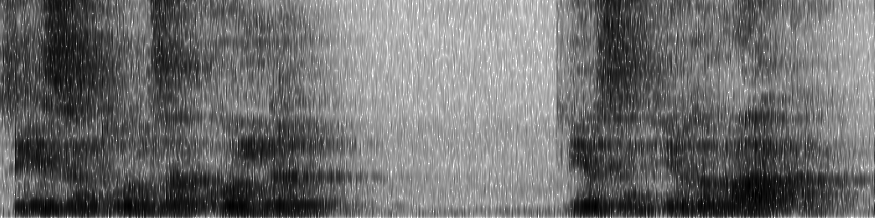
Audio Examples: Original vs. Original (rr)
Figure 4: Spectrogram of Audio file m1_co_sie_3_o.wav (Praat)
Figure 5: Spectrogram of Audio file m1_co_sie_3_orr.wav (Praat)
Notes:
As a second example, I would like to play you the same original recording as before.
This time, you will hear it in the room reverberation condition as well, so you can get a clear impression of how the added room reverberation sounds.

Slide 10
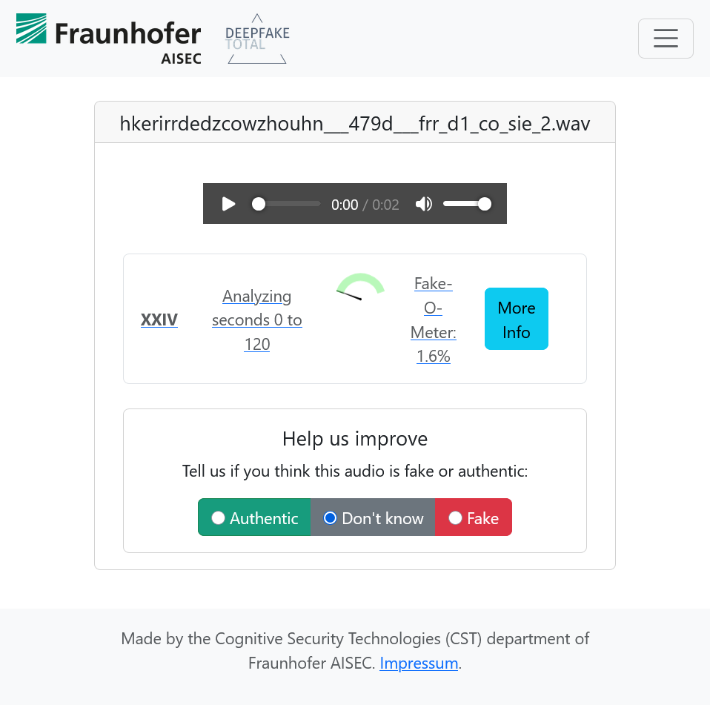
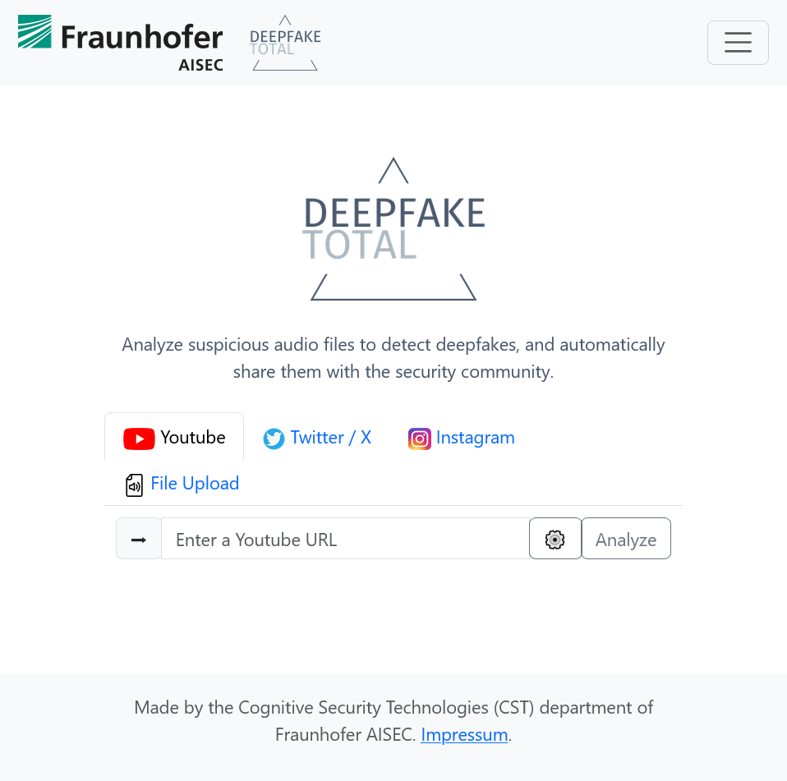
Re-Recordings
Detector: DeepFake Total (DFT)
Input: all six Audio types (o, orr, orrp, f, frr, frrp)
Output: Fake-O-Meter Score in % (higher = more fake)
Range: 0.0 – 100.0%
Figure 6: Web interface of DFT before and after the upload
Notes:
To examine the detectability of audio deepfakes under both room-acoustic and controlled conditions, we tested all audio types: originals, originals with room reverberation, originals with reverberation and plus pause, as well as the corresponding deepfakes under the same three conditions.
Each audio file was manually uploaded to Deepfake Total.
The tool then outputs the so-called Fake-O-Meter Score, which is expressed as a percentage with decimal precision, ranging from 0.0 to 100.0 percent.
Higher values indicate a stronger suspicion of “fakeness”, while lower values suggest a strong match to naturally spoken human speech.

Slide 11
Statistical Methods
3-way ANOVA, saturated model (including all interactions)
Factors:
repeated-measurement:
Audio type (6 levels: f, frr, frrp, o, orr, orrp)
grouping:
Gender (3 levels: d, f, m)
Brand Personality Dimension (BP dim.) (5 levels: si, ex, co, so, ru)
Notes:
Since the scores returned by DeepFake Total suggest a metrical scaling, we consider an ANOVA to be appropriate for the analysis.
We conducted a 3-way ANOVA, with a saturated model,
since the data result from utterances that can be grouped by the Gender of the speakers
as well as the portrayed Brand Personality Dimension,
and we also wanted to test the influence of these factors.
We have chosen type 3 square sums,
since the data is unbalanced,
because there was only one diverse speaker as opposed to 3 female and 3 male ones.

Slide 12
Results from the ANOVA
Effect | DF_{n} | DF_{d} | SS_{n} | SS_{d} | F | p [%] | η²_{G}
Gender | 2 | 20 | 334.11 | 24575.55 | 0.1359532 | 87.37 | 0.4
BP dimension | 4 | 20 | 7062.50 | 24575.55 | 1.4368953 | 25.85 | 8.4
Audio type | 5 | 100 | 160614.52 | 52699.96 | 60.95432 | 7.938∙10⁻²⁷ | 67.5
Gender : BP dim. | 8 | 20 | 9638.45 | 24575.55 | 0.9804922 | 47.89 | 11.1
Gender : Audio Type | 10 | 100 | 12934.74 | 52699.96 | 2.4544111 | 1.15 | 14.3
BP dim. : Audio type | 20 | 100 | 15719.21 | 52699.96 | 1.4913868 | 10.11 | 16.9
Gender : BP dim. : Audio type | 40 | 100 | 15191.71 | 52699.96 | 0.7206696 | 87.80 | 16.4
Correction |  |  |  |  | GGe | p(GGe) [%]
Audio type |  |  |  |  | 0.521 | 4.329∙10⁻¹⁴
Gender : Audio type |  |  |  |  | 0.521 | 4.323
Notes:
So, let‘s have a look at the ANOVA’s results:
At a 5% alpha error level
the factor Audio type turns out to be quite significant
as well as the interaction of Gender and Audio Type
The generalized eta squared… (a measure of effect size)
indicates a very large effect of the factor Audio type
and a medium effect for the interaction between Gender and Audio type
Since the Mauchly sphericity test indicates
variance heterogeneity between the levels of Audio type,
the Greenhouse-Geisser-correction is applied,
which leads to larger error estimates.
But the p-values of the two factors remain significant even with this correction.

Slide 13
Means of DeepFake Total’s Scores (in %)
Audio type | Gender | N | Mean | FLSD low | FLSD high
f | d | 5 | 100 | 90.6 | 109.4
 | f | 15 | 100 | 90.5 | 109.4
 | m | 15 | 99.8 | 90.4 | 109.2
frr | d | 5 | 12.4 | 3 | 21.8
 | f | 15 | 1.9 | -7.5 | 11.3
 | m | 15 | 23.6 | 14.2 | 33
frrp | d | 5 | 4 | -5.4 | 13.4
 | f | 15 | 2.1 | -7.3 | 11.5
 | m | 15 | 15.5 | 6 | 24.9
o | d | 5 | 8.1 | -1.3 | 17.5
 | f | 15 | 31.9 | 22.5 | 41.3
 | m | 15 | 1.4 | -8 | 10.8
orr | d | 5 | 42.1 | 32.7 | 51.5
 | f | 15 | 32.2 | 22.8 | 41.6
 | m | 15 | 35.1 | 25.7 | 44.5
orrp | d | 5 | 32.7 | 23.3 | 42.1
 | f | 15 | 24.1 | 14.7 | 33.5
 | m | 15 | 33.1 | 23.7 | 42.5
Notes:
So, let‘s have a closer --- a post-hoc --- look on the means of the scores grouped by the two significant factors:
We calculated Fisher’s Least Significant Difference in order to determine significantly differing means.
Again, we admit an error level of 5%.
Since so many numbers are a bit difficult to keep track of,
we’ll have a look at a graphical representation.

Slide 14

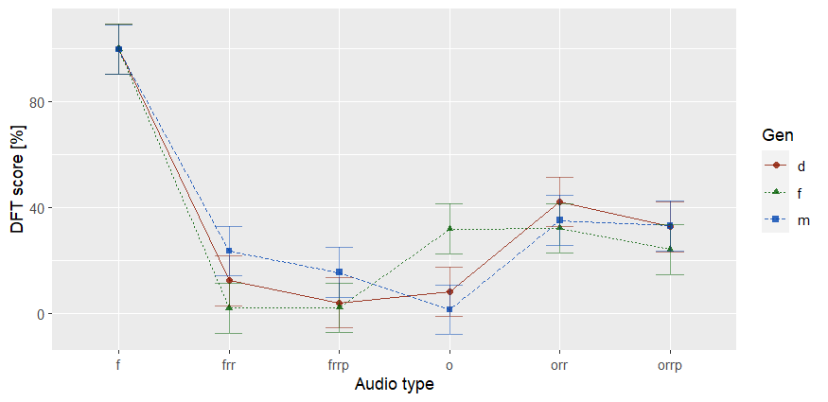
Notes:
Most obviously, we see that the fakes --- regardless of gender --- are correctly classified (as fakes) with hardly any deviations.
…and that the fakes’ scores differ (very) significantly from scores on all other audio types.

Slide 15
Notes:
Really surprising is
that the room fakes are predominantly rated as non-fake!

Slide 16
Notes:
Once more surprising – and somewhat against logic – is
that the room-originals are tendentially rated more fake than the room-fakes.
Some means of grouping pairs even differ significantly:
For example, the room-originals of the diverse and female speakers [red and green]
are significantly classified as more fake than the corresponding room-fakes.

Slide 17
Notes:
Another astounding result is
that female originals are rated just as fake as the room-originals (regardless of gender),
but significantly more fake than the original audios of male or diverse speakers
….which greatly contributes to making the interaction between Gender and Audio type significant.
In addition, DeepFake Total rates female originals as more fake than the female room-fakes.
It should also be noted here
that this high average fakeness assigned to the female originals
is mainly due to only some audios (although from all three female speakers!)
that are classified as fake with a score of almost 100%.

Slide 18
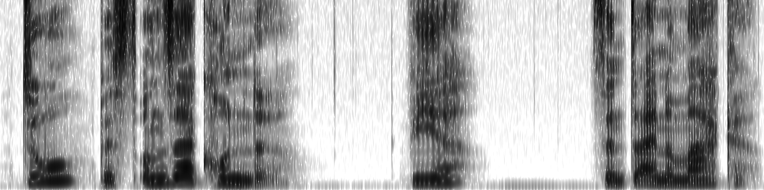
Audio Examples: Misjudged Female Original
Figure 7: Spectrogram of Audio file f3_si_du_2_o.wav (Praat)
Notes:
Here is an example audio that was classified as fake with 99.5% accuracy:
So far, we have not been able to identify any reliable acoustic-phonetic parameters
that could account for these gross misclassifications.

Slide 19
Discussion: Interpretation
DFT interprets room reverberation as strong evidence of authenticity
Severe weakness: DFT seems to show a tendency towards false positives, i.e. misjudges some originals as fake, especially female voices
Current detection tools (at least DFT) not robust under realistic acoustic transformations
Room acoustics may systematically undermine anti-spoofing technologies
Notes:
We can only interpret these results in such a way that DFT takes room reverberation as strong evidence for authenticity.
Further, we found that DFT shows a tendency towards false positives, more precisely, that DFT misjudges originals as fakes -- at least with female voices of our data.
This brings us to the conclusion that (at least DFT) is not robust under realistic acoustic transformations…
and beyond that to the (rather strong) supposition that room acoustics poses severe problems for anti-spoofing technologies.

Slide 20
Discussion: Limitations
Only tested one detector (DeepFake Total)
Used only ElevenLabs’ “Instant Voice Cloning” – not “Professional Voice Cloning”
Small dataset: only best-case utterances of BrandDB

Slide 21
Key Conclusion and Future Work
Room reverberation masks deepfake traces
Gender influences misclassification rates
DeepFake Total appears to rely on misleading acoustic features
Future Work:
Expand dataset (all BrandDB recordings)
Expand duration of samples
Test additional detectors
Investigate “Professional Voice Cloning”
Notes:
Given the results of our study,
we conclude
that room acoustics masks deepfake traces
that – at least with DFT -- gender influences misclassification rates.
and that these shortcomings probably are due to
too small and/or not variable, representative enough training data.

Slide 22
Thank you for your attention
Sophie Hoppe, Anabell Hacker, Markus Brückl | TUB - Chair of Speech Communication | ITG Conference on Speech Communication | 25.09.2025

Slide 23
Means of Deepfake Total’s scores grouped by Audio type and Gender. Error bars are defined by Fisher’s
LSD for an α level of 5% (LSD = 4.58)
Notes:
Here, with 1260 sounds in total, also the triple interaction
Audio type x Gender x BP dimension
shows (on 5% error level) significant differences (pGG = 0.973 %).

